Slide 1








Advance Java
Proudly recognized by

Slide 2
Multi-threading
Introduction to Concurrency
Key Terms
Thread Life Cycle
Java Thread Basics
Thread Methods & Keywords
Thread Safety Problems
Thread Pools
Callable & Future
CompletableFuture
Agenda

Slide 3
Java 8
Streams
Lambda and FUnctional Interface
Additional Concepts
Agenda

Slide 4
Introduction to Concurrency
Why concurrency?
Utilize multiple cores
Faster processing
Handling I/O waits
Keep application responsive

Slide 5
Key Terms
Process
A program in execution. Contains resources like memory, files, CPU time.
Thread
Smallest schedulable unit of execution inside a process.
Task
Unit of work executed by a thread.
Context Switching
CPU switching between tasks/threads to give illusion of parallelism.
Multithreading
Executing multiple threads within the same process for better throughput. Multiprocessing
Multiple CPUs executing multiple processes in parallel.

Slide 6
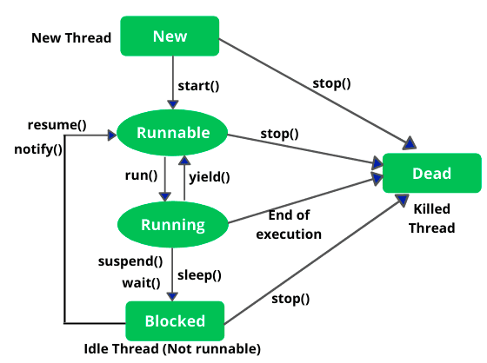
Thread Life Cycle

Slide 7
Java Thread Basics
Creating a Thread
class MyRunnable implements Runnable {
public void run() {
System.out.println("Runnable running...");
}
}
new Thread(new MyRunnable()).start();
class MyThread extends Thread {
public void run() {
System.out.println("Thread running...");
}
}
new MyThread().start();

Slide 8
Thread Methods & Keywords
Inter-thread Communication
wait()
Releases lock and waits.
notify()
Wakes one waiting thread.
notifyAll()
Wakes all waiting threads.
Thread Methods
sleep(milliseconds)
Pause thread for a fixed time.
yield()
Suggest scheduler to let other threads run.
join()
Wait for a thread to finish.
interrupt()
Interrupt a sleeping/waiting thread.

Slide 9
Additional Concepts
Synchronized
Ensures only one thread executes the critical section at a time.
Example:
synchronized (this) {
counter++;
}
Volatile Keyword
Ensures visibility
No caching by threads
Does NOT ensure atomicity

Slide 10
Thread Pools (Executors Framework)
Why thread pools?
Avoid creating threads repeatedly
Improve performance
Manage concurrency efficiently
Types of executors:
newFixedThreadPool(int size)
newCachedThreadPool()
newSingleThreadExecutor()
ScheduledExecutorService
ScheduledExecutorService executorService =
Executors.newSingleThreadScheduledExecutor();
executorService.scheduleWithFixedDelay(
() -> { /* task */ },
1,
10,
TimeUnit.SECONDS
);

Slide 11
Callable & Future
Callable & Future
Callable
Like Runnable but returns a value.
Future
Used to get results or check status.

Slide 12
CompletableFuture
Methods:
thenApply()
thenRun()
allOf()

Slide 13
Java 8 Concepts
JAVA 7 VS JAVA 8

Slide 14
Streams
What is a Stream? A Stream is a sequence of elements that supports functional-style operations.
Why Streams?
Easy and readable data processing
Reduces boilerplate code
Supports operations like filter, map, reduce, sorted, collect
Key points:
Does not store data
Supports lazy evaluation
Can be parallelized
Works with collections and arrays
List<Integer> nums = Arrays.asList(1,2,3,4);
nums.stream().filter(n -> n%2==0).forEach(System.out::println);

Slide 15
Lambda and Functional Interface
Definition: An interface with exactly one abstract method.
Why important? Java 8 features like Lambdas and Streams rely on them.
Examples:
Runnable
Callable
Comparator
Function<T,R>
Predicate<T>
Consumer<T>
@FunctionalInterface
interface MyFunc {
void doWork();
}

Slide 16
Lambda Expressions
What is a Lambda? A short block of code that can be passed around as a function.
Why use it?
Cleaner code
Easier functional programming
Removes unnecessary classes and verbosity
(parameters) -> expression
(parameters) -> { statements }
Runnable r = () -> System.out.println("Running");
Comparator<Integer> c = (a, b) -> a - b;

Slide 17
Optional
Purpose: Avoid NullPointerException and write safer code.
What is Optional? A container object that may or may not contain a value.
Common methods:
isPresent()
get()
orElse(value)
map()
flatMap()
Optional<String> name = Optional.ofNullable(null);
System.out.println(name.orElse("No Name"));

Slide 18
Assignment
Concurrency Goal Implement Producer and Consumer threads that work together using a shared buffer. Requirements
Producer generates numbers 1 to 50
Consumer reads and prints the numbers
Shared buffer size = 5
Producer waits if buffer is full
Consumer waits if buffer is empty
Use wait() & notify()

Slide 19
Assignment
JAVA 8 Given a list: List<Integer> nums = Arrays.asList(3, 10, 15, 8, 21, 14, 7); Task Functional Interface Create a functional interface: NumberRule with method: boolean apply(int n); Lambda Define two rules using lambda: isEven → returns true if number is even, isPrime → returns true if number is prime
Stream Operations Using streams and your lambda rules: Filter numbers that are both even AND prime , Square each filtered number,Collect results into a list Optional Get the first squared number from the result list using Optional, Print the value if present,Else print: "No matching number found"

Slide 20
Thank You

